Slide 1




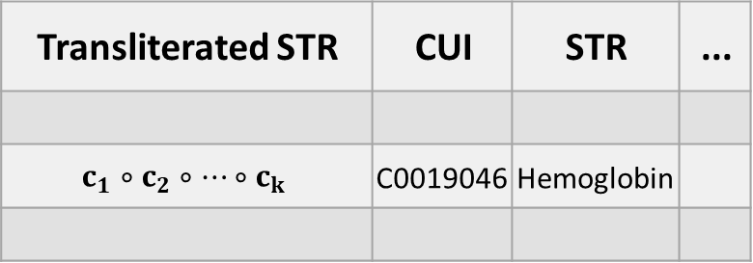
UMLS MRCONSO.RRF
Additional column
Inference on
UMLS STR to
produce
transliteration
... | STR | CUI | Transliterated STR
 | Hemoglobin | C0019046 | $c_{1}∘c_{2}∘…∘c_{k}$
English
medical
terms
Self-supervision
Transliteration model
Finding matches in the UMLS
Receiving
CUI and STR (English)
Forum
Post
Medical terms with CUI and STR
Language Model
UMLS Relatedness
Relevant Medical Terms
Additional features
Online Health Community - Target Language
High Recall Matcher
Contextual Relevance model

